Slide 1
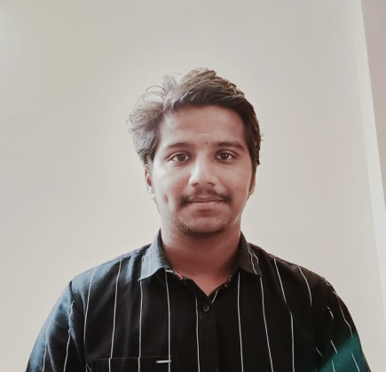


MANOJ KUMAR REDDY PUSAPATI
Bachelor of Technlogy, Computer Science and Engineering : 2018-2022
Analyst/Software Engineer
Skills
C# | Basics, OOPS, Exception Handling ,Arrays ,Collection and Generics, Delegates and Events, File Io and Serialization.
.NET Framework | Architecture which includes CTS,CLS,FCL,BCL and CLR.
Ado.net | Basics Architecture
Database | SQL
Tools | GIT
UI Technology | HTML5 ,CSS & Angular
Add On Skills | Communication Skills, Team Management, UI Designing.
Mumbai
pusapati-manoj-kumar.reddy@capgemini.com
+91 9059087248
A4
Click
Full Stack Developer
Understanding of RDMS concepts using SQL Server.
Practical understanding of C# and SQL concepts using Visual Studio and SQL Server
Hands on experience in developing applications using .NET Framework, ADO.NET Core
Understanding of HTML5 , CSS and Angular Cli
Trained under i-Transform
Completed case study on Pharmacy management system which is a Web based System where user can easily find out drugs in Online. Then user needs to Login. By Login user can decide which service he/she has needs.
Technologies used:
ANGULAR JS
ASP.NET CORE
Microsoft SQL Server
Video Link : Click
GitHub Link

